Slide 1
Oyster Frame Update (6/3/2020)
Raghav Agarwal

Slide 2
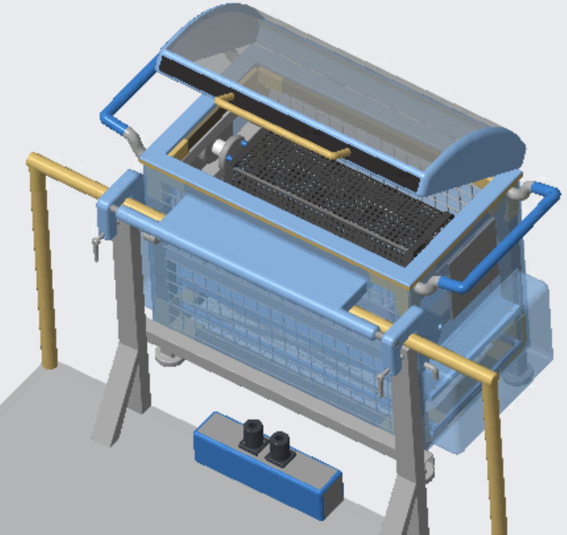
Current Progress
Updates:
Rounded out features
Conical fingers
Protruding sides
Shortened manifold
Raised cage height
Need to add
End-cap jets
Lid latches
Tubing
Resizing of lift (John)
Brush reciprocator assembly (Raghav)

Slide 3
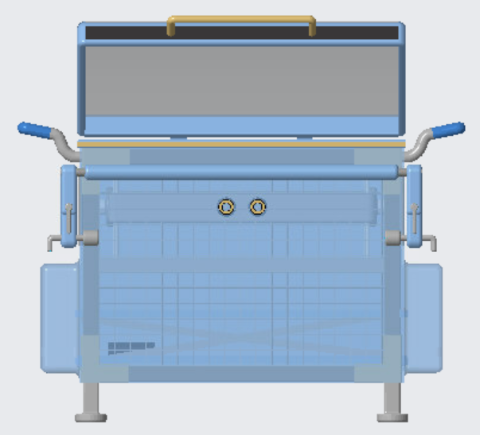
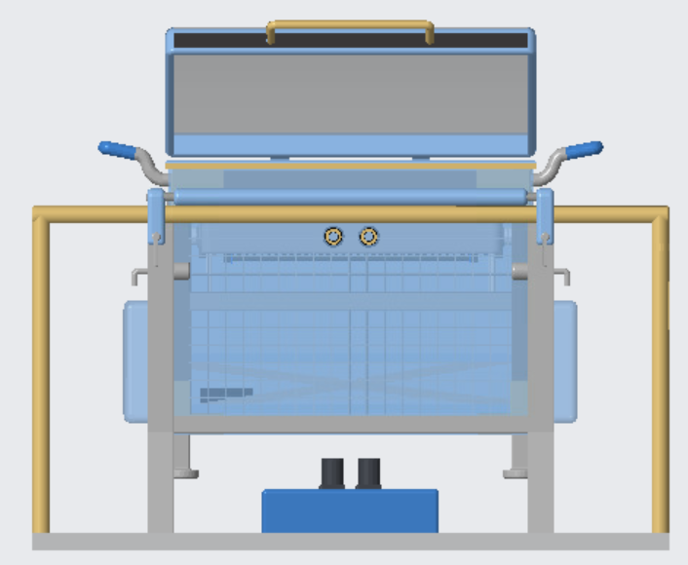
Front View
The sides protrude ~5” here but actually only protrude ~2” in the CAD
Solenoids now point upward from control box and are in line with central manifold inlets
Lift now sits on frame
Can ask John to readjust lift even more

Slide 4
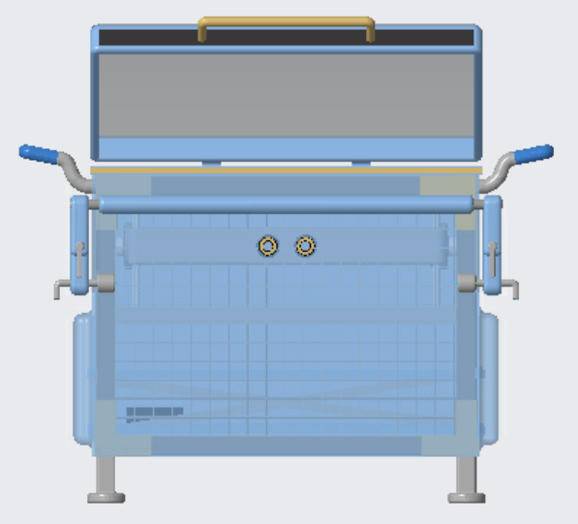
*5” VS 2” Protruded Sides

Slide 5
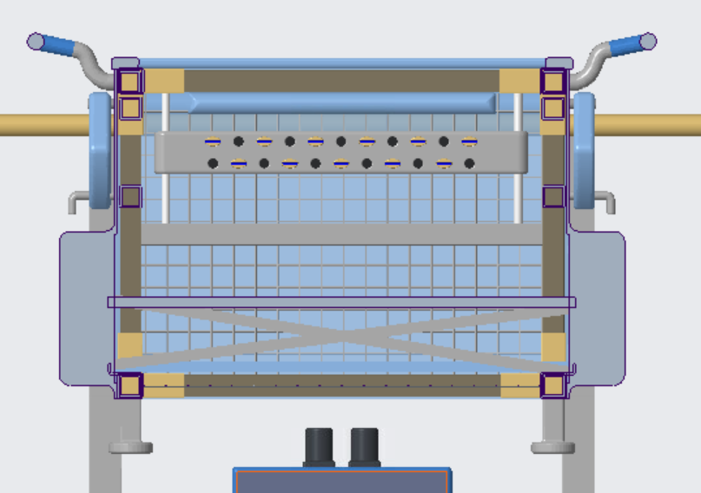
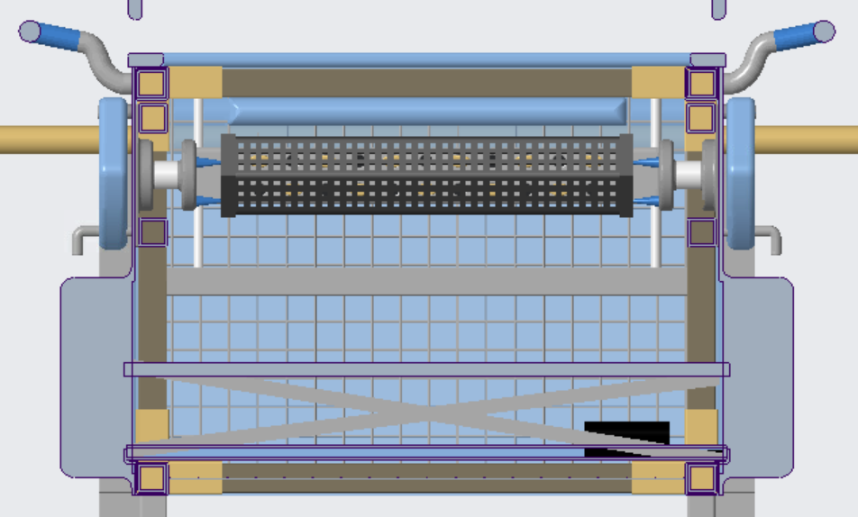
Rear View
3 conical prongs are patterned around the central axis
The manifold height has been reduced
The centerline of the cage is now closer to the lid

Slide 6
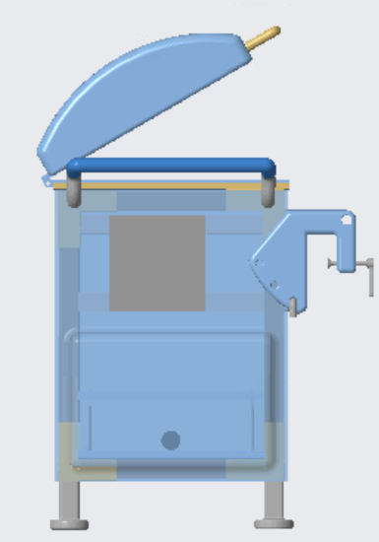
Left View
The protrusions in the sides were only made in the bottom for the sake of time
Can extend the protrusion upwards and veer around the pivot mechanism

Slide 7
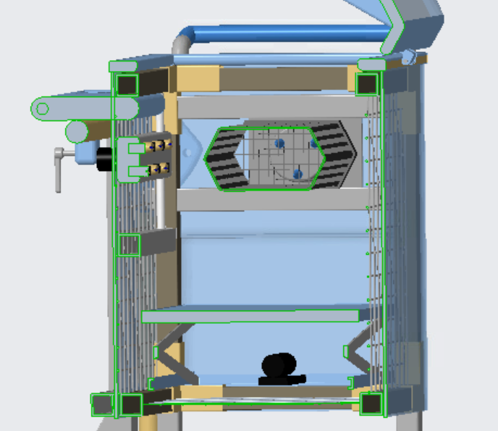
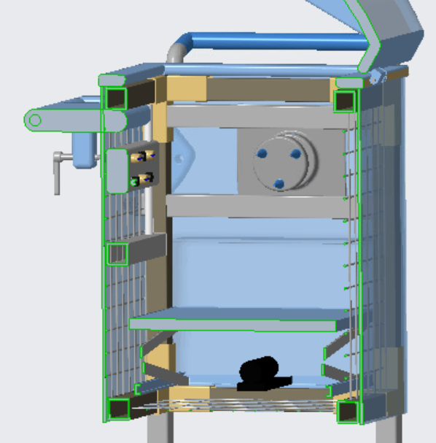
Section View
Manifold path currently limited by pivot arm

Slide 8
6/2/2020 Progress
*Archived Progress from 10:00 AM on 6/2/2020

Slide 9
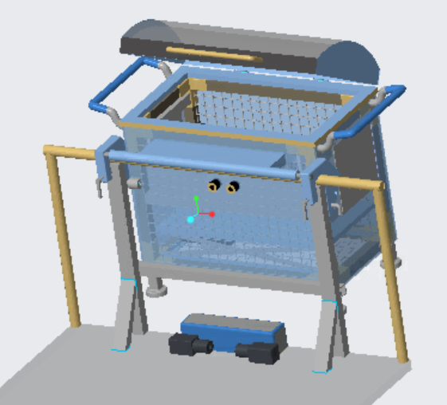
Progress
Updates:
New lift handles
Sliding manifold
Lift
Reduced frame cavity
Bottom frame bar
Need to add
End-cap jets
Lid latches
Aesthetics
Tubing

Slide 10
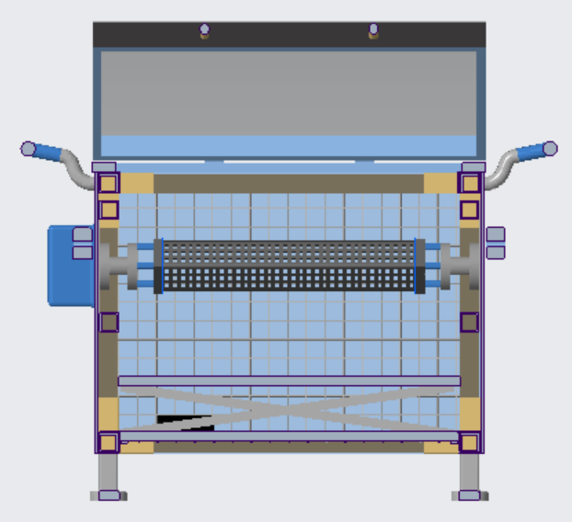
Front View
Can probably bring horizontal plane of cage even closer to the top and reduce overall frame height

Slide 11
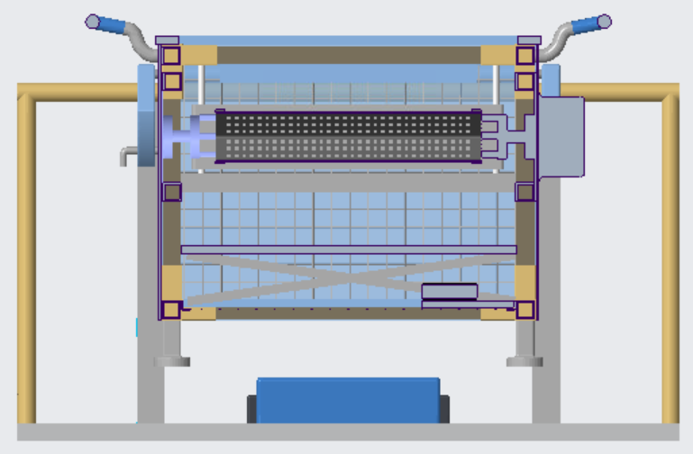
Rear View
Cage sits in middle of two manifold layers
How far should the manifold be able to travel?

Slide 12
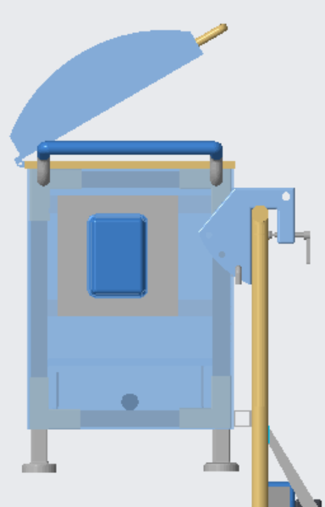
Left View
Kept the centerline of the cage ~6” from the manifold while reducing the clearance at the back
End cap restraints slightly back from cage midplane

Slide 13
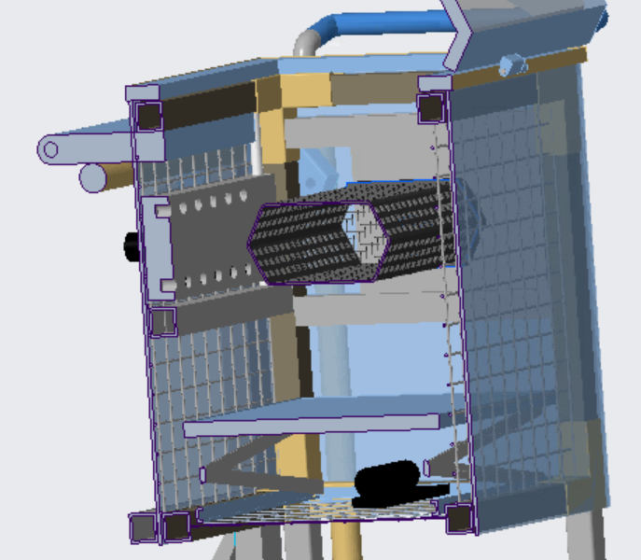
Section View
Lift currently sits on top of bottom mesh
I/John can extend the length of the lift so that it sits on the frame
Currently the pivot arm sits under the frame (was unsure if fastening to the frame’s front face would be strong enough). Is this fine or should I think of a different way to attach it?
Should I reduce the distance between the top and bottom manifold arrays from 5” to say (2.5 to 4)”?
Given that the cage is ~5” in this orientation
*Will add plugs/nozzles to manifold again - it just gets buggy when frequently adjusting the assembly

Slide 14
6/2/2020 Progress
*Archived Progress from 12:30 AM on 6/2/2020

Slide 15
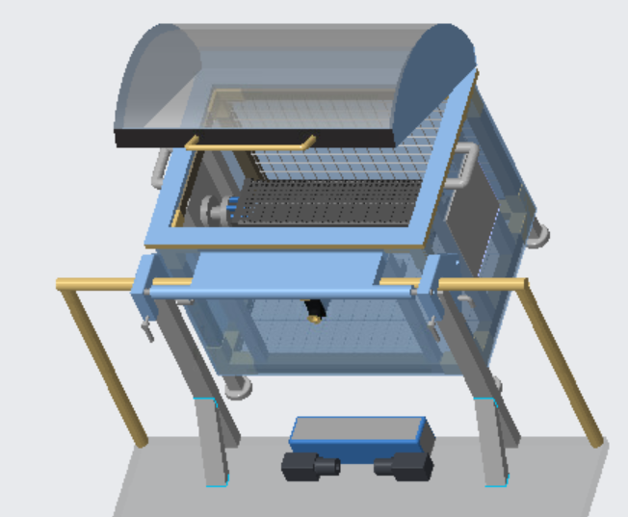
Progress
Current parts/assembly files updated to “Oyster_Washing_Shared” 🡪 “Frame” 🡪 “Chayce”
Need to add
End-cap jets
Lid latches
Aesthetics
Tubing

Slide 16
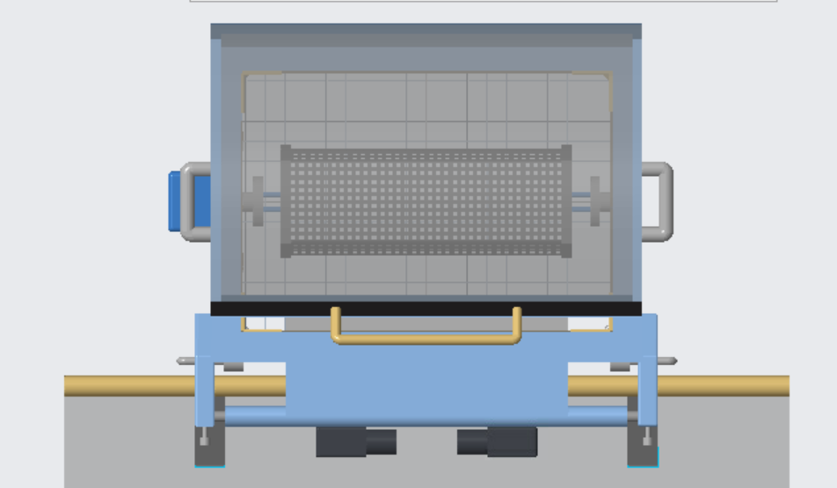
Cage Loaded
Oyster cage loaded with the frame lid open – top view
Updated hexagonal cage to more realistic dimensions (10 mm 25L Hexcycl model)

Slide 17
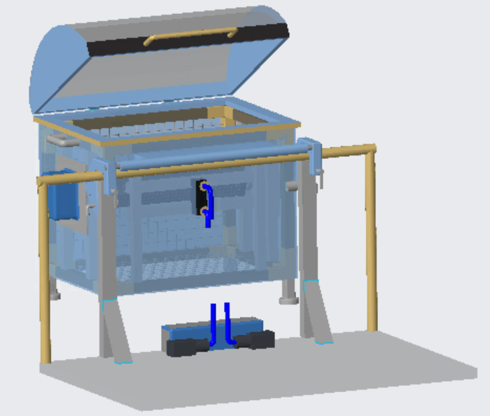
Cage Loaded
*Blue pipes indicate tubing between pumps and manifold – did not have time to update them
*Currently suppressed the pipes in the assembly
Control box and two pneumatic pumps on boat edge

Slide 18
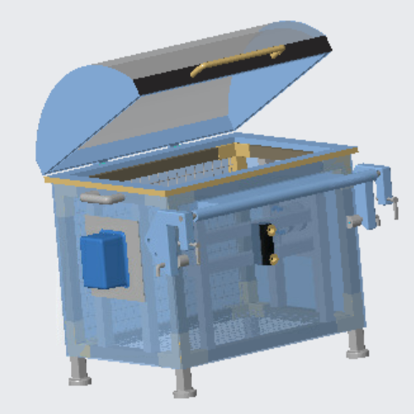
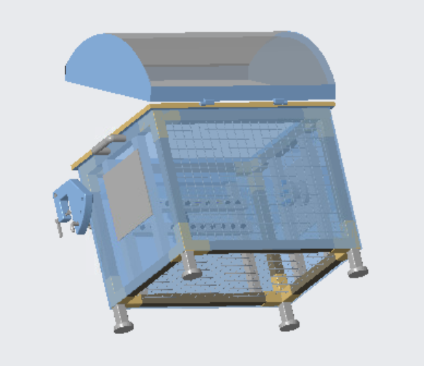
Frame Assembly
Manifold inlet moved to front of frame
Wire mesh have been added to the back and bottom
Bottom is 14-gage
Back is slightly larger gaged

Slide 19
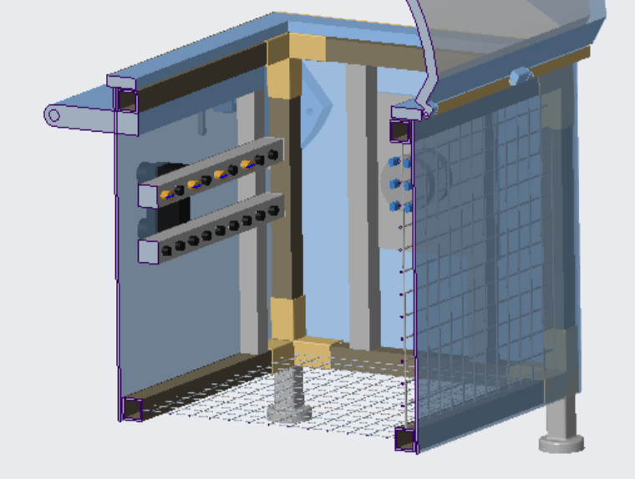
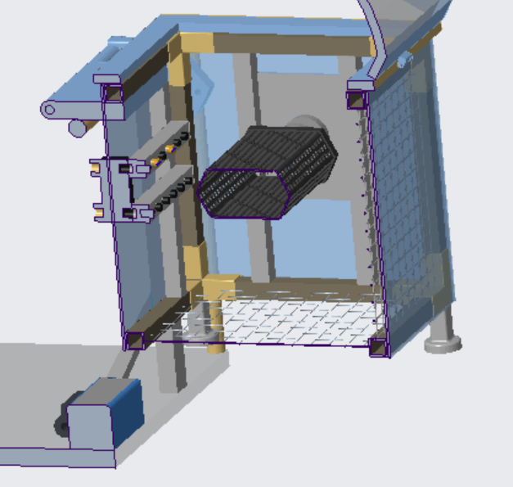
Motor-Manifold Section
Fixed central manifold positions
*Can update to adjustable height system

Slide 20
6/1/2020 Progress
*Archived Progress from 3:30 AM on 6/1/2020

Slide 21
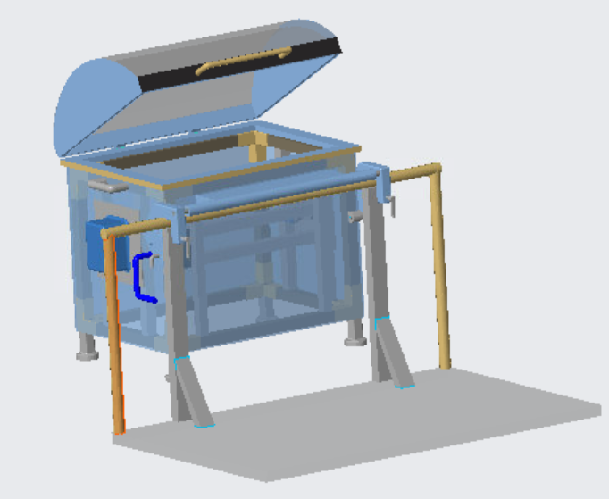
Progress
Current parts/assembly files updated to “Oyster_Washing_Shared” 🡪 “Frame” 🡪 “Chayce”
Need to add
Pump on boat deck
End-cap jets
Lid latches
Wire mesh flooring
Oyster cage within frame
Wire mesh front/back (from John)

Slide 22
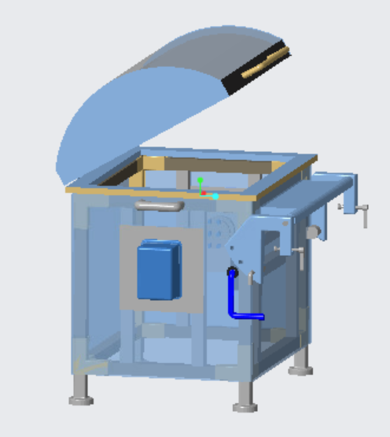
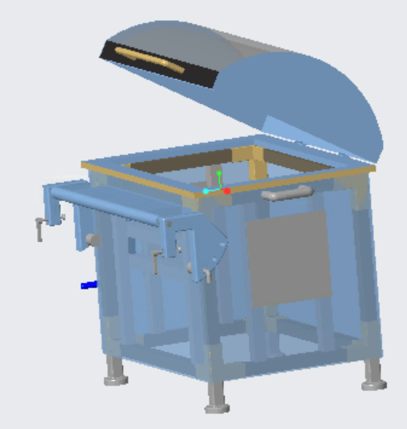
Frame Assembly
Vertical members support the end-cap restraints and indexing motor
Inlet tubing to central manifold on same side as indexing motor
Blue tube indicates water

Slide 23
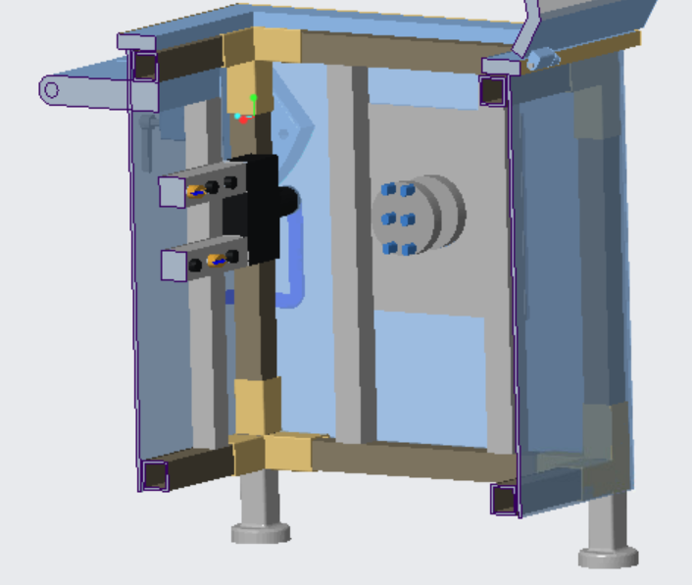
Motor-Manifold Section
Central manifold pair symmetric with central plane of cage
Black box attached to manifold pair represents valve

Slide 24
6/1/2020 Progress
*Archived Progress from 8:00 AM on 6/1/2020

Slide 25
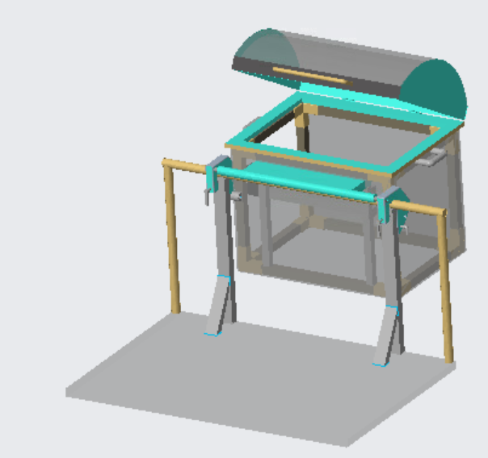
8:00 AM Progress
Current parts/assembly files updated to “Oyster_Washing_Shared” 🡪 “Frame” 🡪 “Chayce”
Need to add
Tubing and pump
Lid latches
Legs and wire mesh flooring
Motor/Housing and cage restraints (from Raghav)
Wire mesh front/back (from John)

Slide 26
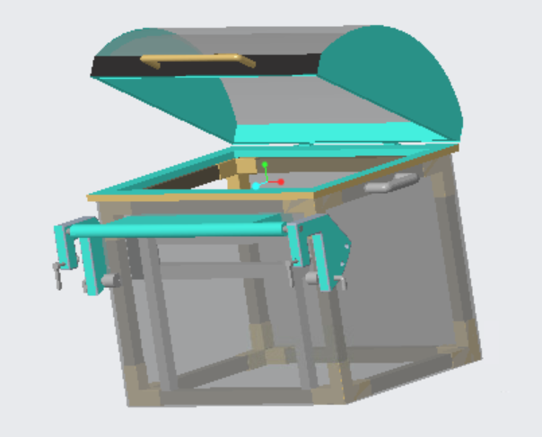
8:00 AM Frame Assembly
Device mounted onto boat railing by two people
Each grasping the two respective handles on their sides; one integrated into the pivot and one integrated into the side of the frame
Red circles indicate the two grasping points for one of the two handlers

Slide 27
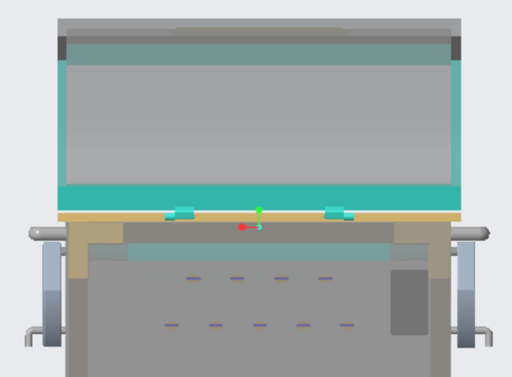
8:00 AM Lid Assembly
Plastic lid with plexiglass sides
Simple hinge on the back of the lid

Slide 28
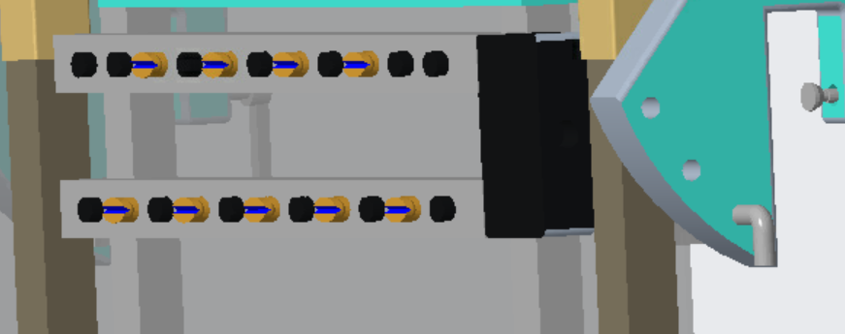
8:00 AM Manifold Assembly
Unsure if this was the exact layout discussed
A top and bottom manifold (positioned at top and bottom of ~5” tall cage; straddles center line)
Plugs indicated in black and nozzles indicated by bronze

Slide 29
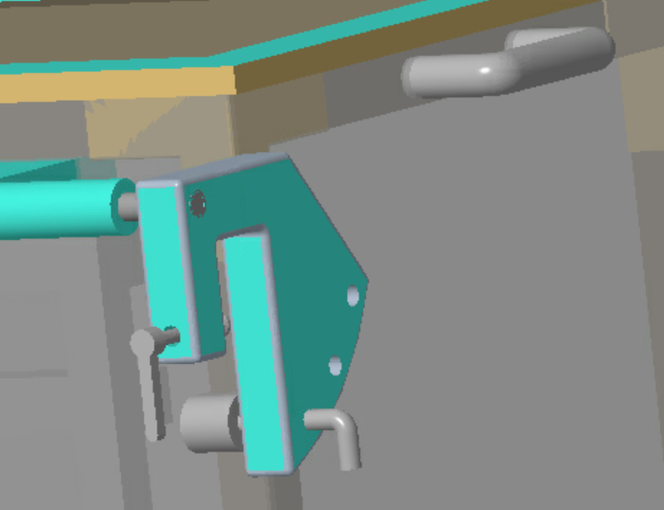
8:00 AM Clamp Assembly
Angles range from 0 – 30 degrees
Angle offset with respect to the vertical orientation of the frame
Simple pin slots to set frame to desired pivot angle
Screw to secure clamp

